Slide 1
Cloning vectors
“The introduction of a foreign DNA into a host cell in many cases requires the use of a vector. Vectors are DNA molecules used to transfer a gene into a host (microbial, plant, animal) cell, and to provide control elements for replication and expression. The vector to be used is determined by the type of host cells and the objectives of the cloning experiment.”

Slide 2
Vectors for different situations
Vectors for Bacterial Cells
Plasmid Vecors
Bacteriophage Vectors
Cosmids
Phagemids
Yeast Cloning Vectors
The 2μ Circle
Vectors for Plant Cells
Binary Vector System
Cointegrative Vector System
Genetic Markers
Plant Specific Promoters
Vectors for Mammalian Cells
SV40 Viral Vectors
Direct DNA Transfer
Insect Baculovirus
Retrovirus

Slide 3
Vectors for Bacterial Cells: Plasmid Vectors
Extrachromosomal DNA having following properties:
Ori
Cloning sites : MCS (multiple cloning sites)
Selectable markers: Amp^{R}, Tet^{R}
Promoter upstream to MCS in expression vectors
polyhistidine sequence: optional but popular
(e.g. 5'-CACCACCACCACCACCAC encoding 6 histidines) so that the expressed protein will have a short polyhistidine fused either at the N- or C-terminus.

Slide 4
Typical plasmid vector

Slide 5
Low and High Copy Plasmids.
Low copy (1-25): pBR322
High copies (100 or more): pUC
Copy number depends on:
Ori (relaxed or stringent control: specificity)
Size of the plasmid and
Associated insert
Notes:
Stringency can be regarded as the speciﬁcity with
which a particular target sequence is detected by
hybridization to a probe. Thus, at high stringency,
only completely complementary sequences will be
bound, whereas low-stringency conditions will allow
hybridization to partially matched sequences.

Slide 6
pUC Plasmids
http://serc.carleton.edu/microbelife/research_methods/genomics/clonevec.html

Slide 7
pUC Plasmids
An expression vector
β-lactamase gene (ampicillin resistance, Amp^{R})
ampicillin resistance gene is a selectable marker
Truncated lacZ (β-galactosidase): involves in α-complimentation
A cluster of recognition sites, MCS, for a number of restriction enzymes is inserted into the lacZ' region.

Slide 8
α-complementation
Differentiation between recombinant vector from normal vector having selectable marker gene
White colonies: having recombinant vector
Blue colonies: normal vector having selectable marker

Slide 9
Selection of transformants using a pUC plasmid vector

Slide 10
Promoters and RNA Polymerases
E. coli expression vector system controlled by T7 RNA polymerase

Slide 11
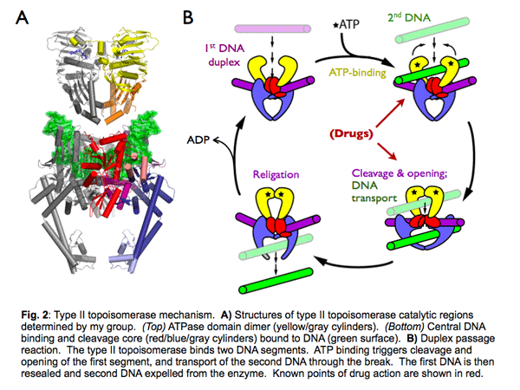
Topoisomerase
http://mcb.berkeley.edu/index.php?option=com_mcbfaculty&name=bergerj

Slide 12
Topoisomerase-based Cloning
Biological function perform by topoisomerase is to cleave and rejoin DNA during replication.
Binding and cleavage due to pentameric motif 5‘-(C or T)CCTT in duplex DNA.
Both sticky end and blunt end ligations can be performed.

Slide 13
Complex formation by enzyme in between a tyrosine residue and the 3' phosphate of the cleaved DNA strand. Further phospho-Tyr bond is attacked by the 5'-OH of the original cleaved strand or of another donor DNA, resulting in religation and releasing the enzyme from the complex.
http://www.psychiatrictimes.com/display/article/10165/89383

Slide 14
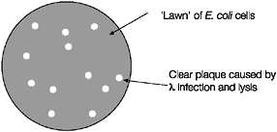
Bacteriophage (Phage) Vectors bacteriophage λ and Ml3
λ vector: cDNA or Genomic library construction
M13: Obtain ssDNA for DNA sequencing
integrated form of λ DNA is called a prophage.

Slide 15
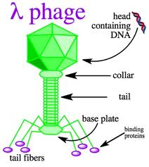
Life cycle of bacteriophage λ

Slide 16
Phage λ Vectors

Slide 17
The λ vector contains a lacZ gene and a unique EcoRl restriction site at the 5' end of the gene.
In the λ vector the genes related to integration are deleted, and thus no induction is required to switch from lysogenic to the lytic mode.
Amber (nonsense) mutations are introduced in the genes required for lytic growth.

Slide 18
Bacteriophage M13 Transformation and Viral Transfection
The transformation of bacteriophage M13 into bacterial cells is identical to plasmid DNA transformation through the heat shock step. After the heat shock step, single stranded M13 DNA begins replicating in the host cell through use of the host cell machinery. During the life cycle of this virus, however, M13 replicative form is created and daughter phages are packaged and extruded from the bacterial cell. These intact phage molecules then infect neighboring bacteria in a process called transfection. When these transformed and transfected bacteria are plated with non-infected cells onto growth media, the non-infected cells form a background cell lawn which covers the plate. In regions of M13 transfection, areas of slowed growth, called plaques, can be identified as opaque regions which interrupt the lawn.
http://www.genome.ou.edu/protocol_book/protocol_adxF.html

Slide 19
Replicative form (RF)

Slide 20
Some other information about M13
The M13 phage DNA is not infectious, but bacterial cells can pick up both ss and RF forms with CaCl2 treatment in the same way as plasmids.

Slide 21
Cosmids
Cosmids are plasmids containing a bacteriophage λ cos site. The hybrid structure enables insertion of large DNA fragments. The λ cos site is required for recognition in packaging.

Slide 22
Cosmid replicates like a plasmid and is packaged like phage λDNA

Slide 23
Phagemids
Vectors have been designed to combine features from filamentous phage and plasmid.
- A filamentous phage origin of replication enables the production of ssDNA under the infection with a helper (filamentous) phage.
Structural organization of a phagemid

Slide 24
Yeast Cloning Vectors
Yeast cloning vectors have been developed based on a plasmid, called 2μ circle, found in yeast.
The 2μ circle is 6318 bp in size, and present in the nucleus of most Saccharomyces strains at ~60-100 copies.
Frequent choice as an appropriate host system for the production of proteins that may require posttranslational modification for full biological activity.

Slide 25
Structural organization of a yeast expression vector

Slide 26
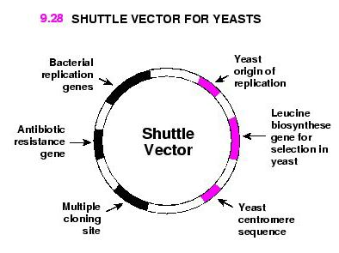
Shuttle Vector
Some yeast vectors also contain a replication origin from an E. coli plasmid (e.g. pBR322 Ori, ColEl On), and a selectable marker that enables the vector to work in a bacterial host. This type of vectors that can operate in both yeast and E. coli, is called a "shuttle vector“
Using a shuttle vector allows DNA manipulation to be conducted by conventional procedures in bacterial system, and the final gene construct can be placed in yeast for expression.

Slide 27
Vectors for Plant Cells
The Ti (tumor-inducing) plasmid is widely utilized to introduce DNA into plant cells
The Ti plasmid is isolated from Agrobacterium tumefaciens, a soil bacterium that infects plants, causing the formation of crown gall (tumor tissue).
In the infection process, a small (~20 kb) segment called T-DNA in the Ti plasmid is transferred and integrated into the plant chromosome.
The transfer is controlled by the vir (virulence) gene located in the Ti plasmid

Slide 28
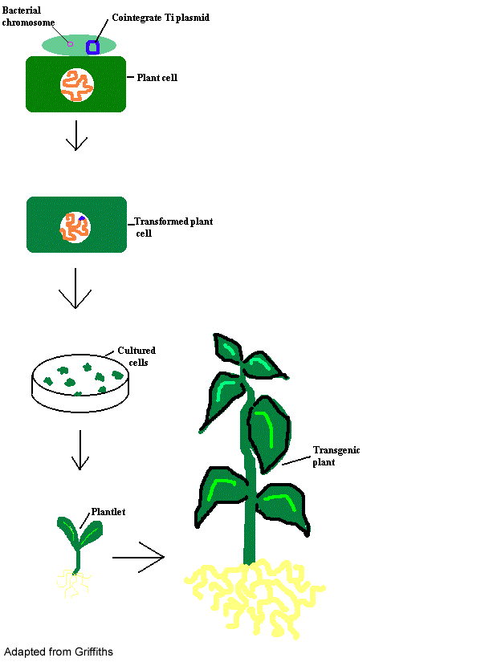
How do you make the plant transgenic?

Slide 29
Binary Vector System
The two plasmids function in a complementary manner.

Slide 30
Structural organization of donor plasmid

Slide 31
Cointegrative Vector System

Slide 32
http://www.bio.davidson.edu/people/kabernd/seminar/2002/method/msmeth/ms.htm

Slide 33
Infection of plant cells by Agrobacterium

Slide 34
Genetic Markers

Slide 35
Viral vectors for gene therapy
Generic strategy for engineering a virus into a vector
KAY, M.A., et al. (2001). NATURE MEDICINE, 7 (1)

Slide 36
Generic strategy for engineering a virus into a vector
Helper DNA:
The helper DNA contains genes essential for viral replication placed in a heterologous/unrelated DNA context that can be delivered as a plasmid, helper virus or stably inserted into the host chromosomal DNA of the packaging cell.
The helper DNA lacks the packaging domain (ψ) so it itself or its RNA cannot be packaged into a viral particle.
Vector DNA
The vector DNA contains the therapeutic expression cassette and non-coding viral cis-acting elements that include a packaging domain.
KAY, M.A., et al. (2001). NATURE MEDICINE, 7 (1)

Slide 37
Transduction of the target cell
KAY, M.A., et al. (2001). NATURE MEDICINE, 7 (1)

Slide 38
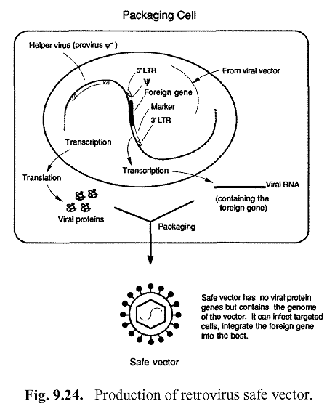

Slide 39
Hypothesis behind using severe causative agent as vector
Make two incomplete structure rather than taking one complete structure to regulate distribution.
Both the part should not rejoin in host system. For the same remove the gene responsible for integration.

Slide 40
Reference
Books and Reviews:
Wong, D. W. S. (2006). The ABCs of Gene Cloning, Springer, 2nd Ed.
Primrose, S.B., Twyman, R.M.(2001). Old, R.W. Principle of Gene Manipulation, Blackwell , 6th Ed.
KAY, M.A., et al. (2001). Viral vectors for gene therapy: the art of turning infectious agents into vehicles of therapeutics. NATURE MEDICINE, 7 (1), 33-40.
Website:
http://www.psychiatrictimes.com/display/article/10165/89383
http://mcb.berkeley.edu/index.php?option=com_mcbfaculty&name=bergerj
http://serc.carleton.edu/microbelife/research_methods/genomics/clonevec.html

